Slide 1
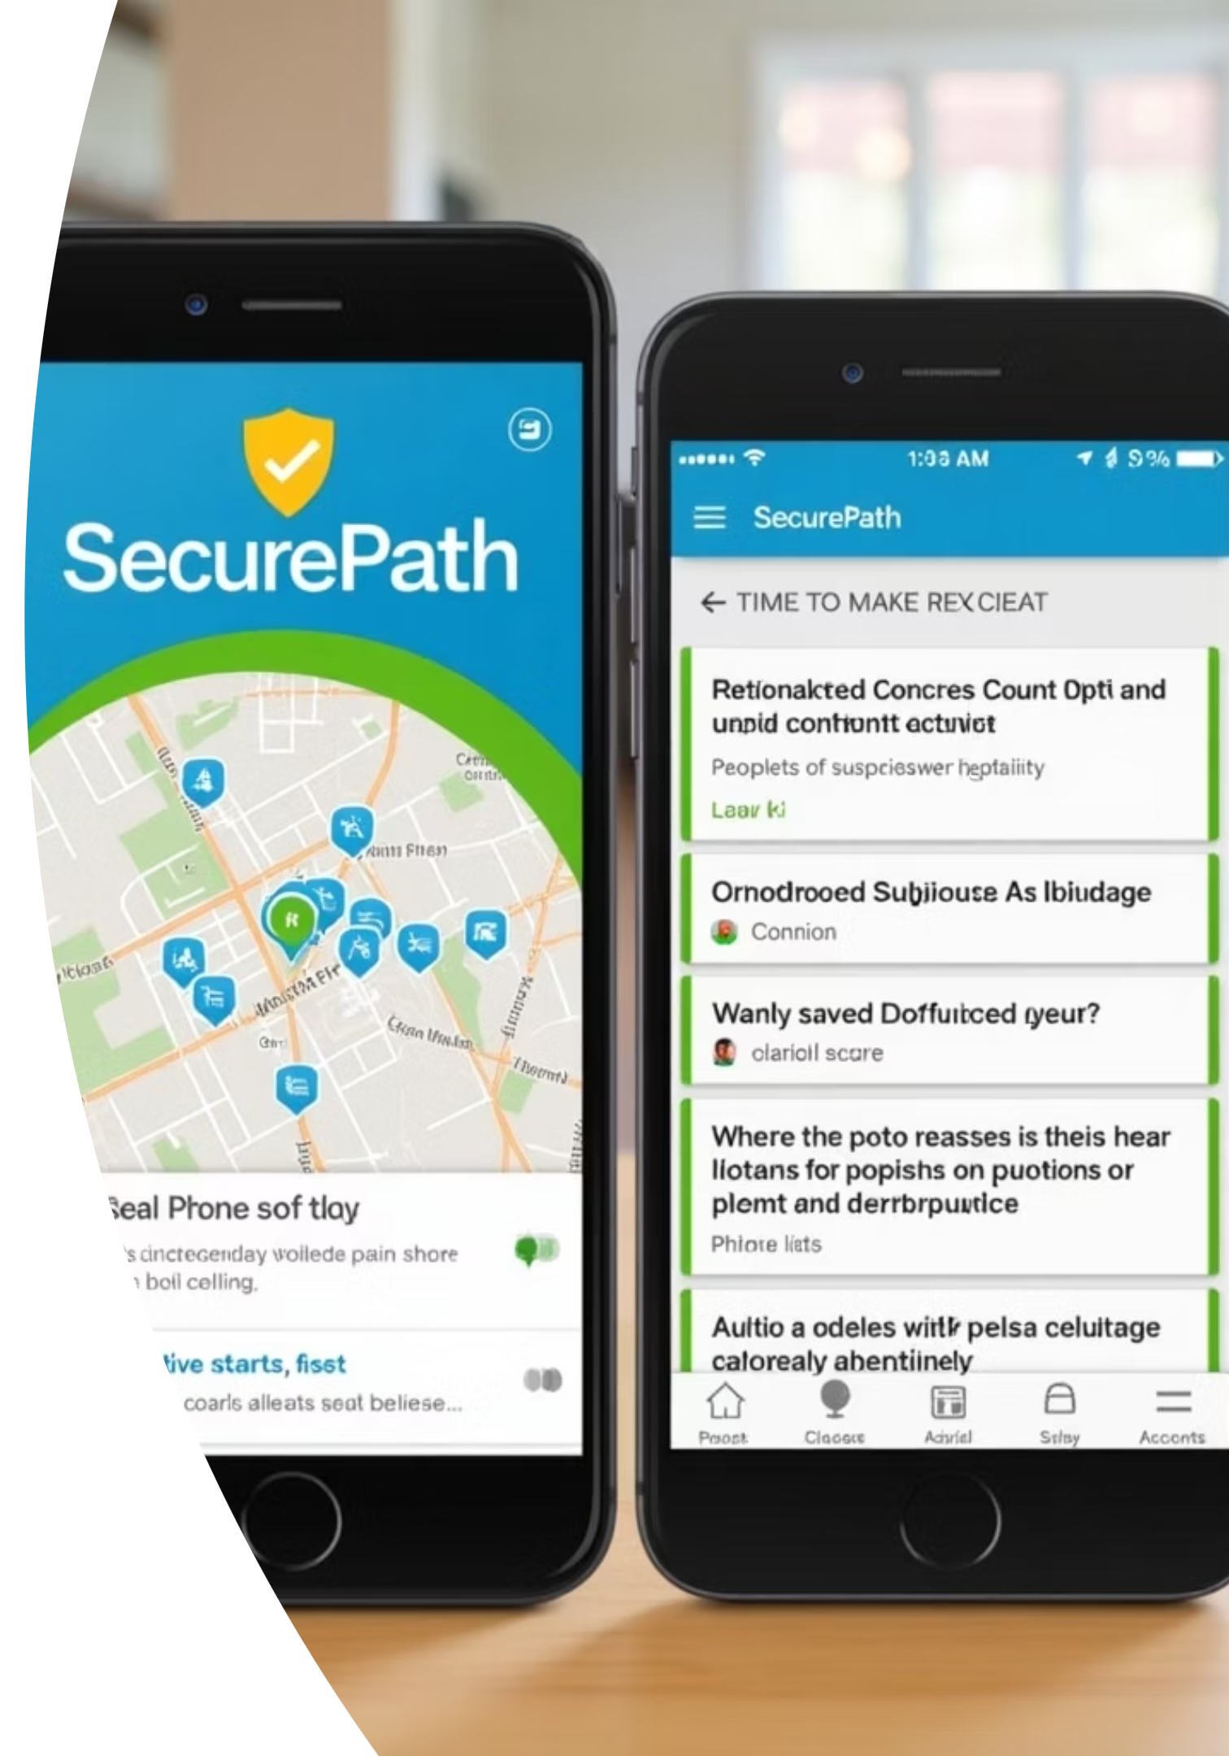
SecurePath: Revolutionizing Neighborhood Safety with Real-Time Verified Alerts
Transforming personal safety from reactive measures to proactive, community-driven protection.

Slide 2

The Problem: Unsafe Travel in Our Communities
Millions face risks from crime, accidents, and unsafe travel routes, creating widespread anxiety, especially during night hours or in unfamiliar areas.
Lack of real-time, verified safety information leaves people vulnerable and unprepared.
Traditional safety alerts are often delayed, unverified, or inaccessible when critical information is needed most.
The current systems lead to a sense of isolation and high cognitive load when planning travel.

Slide 3
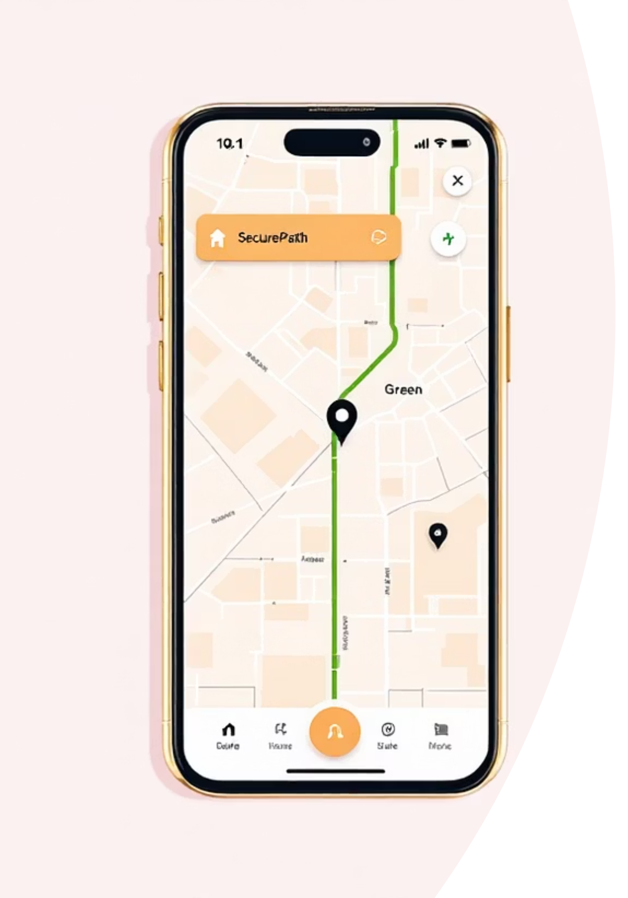

Introducing SecurePath: Your Real-Time Neighborhood Safety Network
SecurePath is more than an app; it's a platform built on trust, verification, and community connectivity.
Verified Alerts
Safe-Route Navigation
Crowdsourced reports combined with official updates ensure trusted, actionable safety intelligence.
Proprietary mapping dynamically guides users away from potential danger zones in real time.
Instant Connectivity
A mobile app instantly connects community members with each other and local safety authorities.

Slide 4

How SecurePath Works: Community & Authority Collaboration
Our multi-layered system ensures rapid reporting, rigorous verification, and immediate response.
Verify Alert
Report Incident
Broadcast Alert
Adjust Route
SecurePath turns every user into a guardian, creating an always-on security perimeter for the neighborhood.

Slide 5
Key Features & Benefits for Users
SecurePath delivers tangible safety improvements and peace of mind with every journey.
Reduced Risk Exposure
Increased Confidence
Real-time alerts have been shown to reduce user exposure to crime and accidents by up to 40% in pilot areas.
Safe-route navigation provides the confidence needed for night travel, unfamiliar roads, and daily commutes.
Community Empowerment
Rapid Response Link
Fosters shared safety responsibility through instant communication and collaborative intelligence gathering.
Direct connection to emergency services and our security partners ensures the quickest possible on-ground support.

Slide 6



Behind the Scenes: Technology & Verification
Our commitment to reliable information is built on sophisticated technology designed for accuracy and speed.
AI Verification
Data Privacy
Intuitive Design
Advanced geolocation combined with AI algorithms minimize false reports and prioritize critical alerts instantly.
Secure, end-to-end encrypted data sharing ensures user privacy and maintains system trustworthiness.
User-friendly interface is optimized for quick, one-tap reporting and effortless alert reception in high-stress situations.

Slide 7

Strategic Partnerships: Enhancing Reliability and Reach
SecurePath is powered by two industry-leading security providers, ensuring verified data and on-ground excellence.
Citi Protection SA
A leader in cutting-edge security solutions, providing verified data feeds and rapid incident response infrastructure.
Expertise in digital monitoring and response.
Contributes advanced predictive analytics to the SecurePath platform.
Maximum Security Services
A trusted local authority with deep community ties, offering proven effectiveness and crucial on-ground support.
Provides immediate physical response to critical alerts.
Enhances geographic coverage and local intelligence.

Slide 8

Real Impact: Early Success Stories
The initial deployment of SecurePath has demonstrated significant positive changes in community safety metrics.
35%
10K+
92%
Incident Reduction
Active Users
User Confidence
Reduction in reported nighttime incidents during the 6-month pilot program in Johannesburg.
Daily active users reporting and receiving alerts, creating a powerful, interconnected safety net.
Percentage of users reporting increased peace of mind and safer travel choices since adopting SecurePath.
The success of the pilot highlights the effectiveness of combining crowdsourcing with professional security verification.

Slide 9

Join the Movement: How You Can Stay Safe with SecurePath
SecurePath requires active participation to maximize its benefit. Join us in building a safer, connected community for everyone.
Download the App
Available for free on both iOS and Android platforms. Get set up in less than two minutes.
Engage Actively
Report incidents, share verified alerts, and always use safe-route navigation for daily planning.
Partner with Your Neighbors
Encourage community awareness and coordinate with local authorities to enhance regional coverage.

Slide 10


SecurePath: Empowering Communities, Protecting Lives
Safety is a Path We Walk Together
We believe that safety should be a shared, real-time solution, transforming vulnerability into collective strength.
With SecurePath and our trusted partners, no one has to feel alone or unsafe when traveling through their neighborhood.

